Slide 1
Ocean Thermal Energy
Energy is available from the ocean by
Tapping ocean currents
Using the ocean as a heat engine
Tidal energy
Wave energy

Slide 2
The ocean as a heat engine
There can be a 20° difference between ocean surface temps and the temp at 1000m
The surface acts as the heat source, the deeper cold water acts as a heat sink.
Temperature differences are very steady
Florida, Puerto Rico, Hawaii and other pacific islands are well suited to take advantage of this idea.
Called OTEC (Ocean Thermal Energy Conversion)

Slide 3
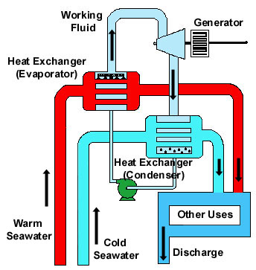
Types of Ocean heat engines
Closed cycle system
Heat from warm seawater causes a fluid like ammonia to be evaporated in an evaporator
Expanding vapor rotates a turbine connected to an electric generator.
Cold seawater is brought up and cools the ammonia vapor in a condenser. This liquid returns to the evaporator and the process repeats.

Slide 4
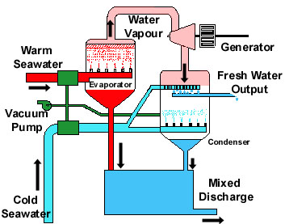
Types of OTECs
Open Cycle Systems
Working fluid is the seawater.
Warm seawater is brought into a partial vacuum.
In the vacuum, the warm seawater boils and the steam drives a turbine
The steam enters a condenser, where it is cooled by cold seawater brought up form below and it condenses back into liquid and is discharged into the ocean.

Slide 5
Boiling water in a vacuum
The boiling point of any liquid depends upon temperature and pressure.
Boiling occurs when the molecules in the liquid have enough energy to break free from surrounding molecules
If you reduce the pressure, you reduce the amount of energy needed for the molecules to break free.
Creating a vacuum reduces the air pressure on the molecules and lowers the boiling point.

Slide 6
OTECs
Carnot Efficiency is low, only about 7%
Net efficiency even lower, only about 2.5%
Low efficiencies require large water volumes to produce appreciable amount of electricity
For 100 mW output, you would need 25 X 10⁶ liters/sec of warm and cold water.
For a 40 mW plant, a 10 meter wide intake pipe is needed. This is the size of a traffic tunnel.

Slide 7
History of OTECs
Jacques d ‘Arsonval in 1881 first proposed the idea
Completed by his student, Georges Claude in 1930. (Claude also invented the neon lightbulb)
Claude built and tested the first OTEC system
Not much further interest until the energy crisis of the 1970s.
In the 1970s, US DOE financed large floating OTEC power plant to provide power to islands
One was built in Hawaii.
Little further support

Slide 8
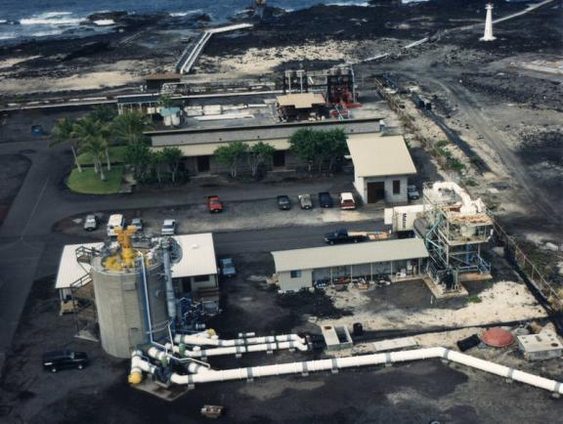
OTEC Plant on Keahole Point, Hawaii

Slide 9
Other uses for OTEC plants
Generate Hydrogen for use as a clean fuel source
Generate fertilizer from biological nutrients that are drawn up from the ocean floor in the cold water intake.
Source of ocean water to be used as drinking water via desalination (taking out the salt).

